Slide 1






Lecture 04
Safe Lab Procedures and Tool used
CT4005NI - Computer Hardware and Software Architectures

Slide 2
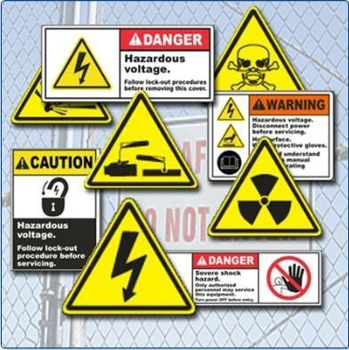
Lecture 04’s
This chapter covers basic safety practices for the workplace, hardware and software tools, and the disposal of hazardous materials.
Objectives
Explain the purpose of safe working conditions and procedures.
Identify tools and software used with personal computer components and their purposes.
Implement proper tool use.

Slide 3
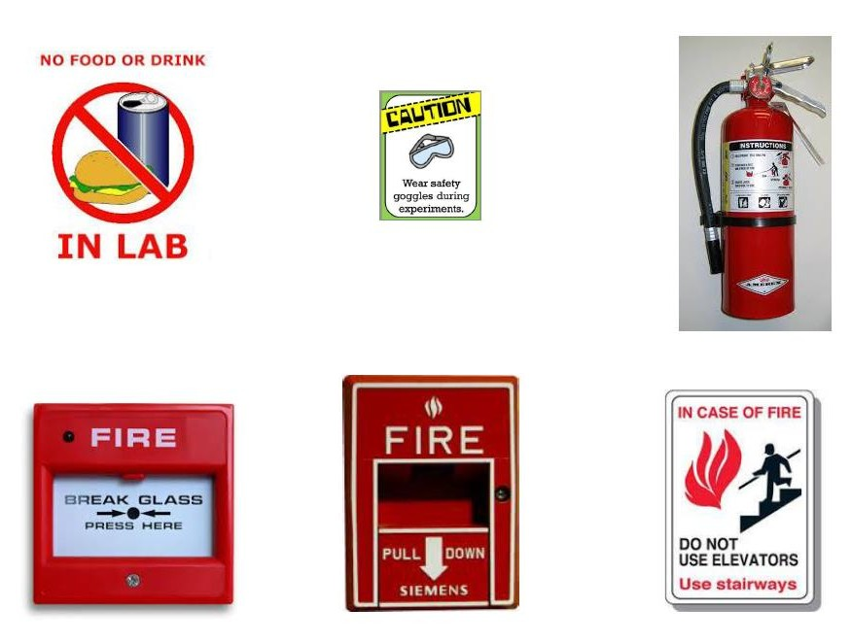

Slide 4
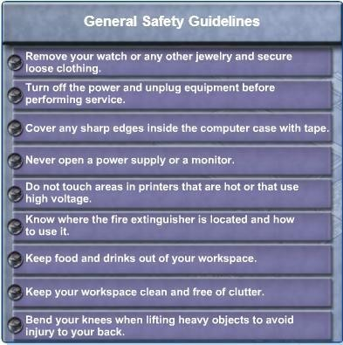
4.1 Explain the purpose of safe working conditions and Procedures
4.1.1 Identify safety procedures and potential hazards for users and technicians
General Safety Guidelines:
Follow the basic safety guidelines to prevent cuts, burns, electrical shock, and damage to eyesight.

Slide 5
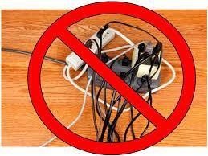
4.1 Explain the purpose of safe working conditions and Procedures
4.1.1 Identify safety procedures and potential hazards for users and technicians
Electric Safety Guidelines:
Follow electrical safety guidelines to prevent electrical fires, injuries, and
fatalities in the home and the workplace.
Power supplies and monitors contain very high voltage hence experienced technicians should attempt to repair it. Others should just replace it.
Electrical devices have certain power requirements, hence exchanging power codes with different type of laptops or device may damage both adapter and device, for instance.

Slide 6
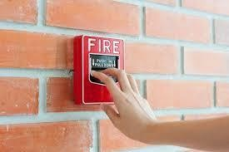
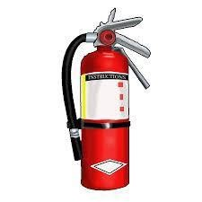
4.1 Explain the purpose of safe working conditions and Procedures
4.1.1 Identify safety procedures and potential hazards for users and technicians
Fire Safety Guidelines:
Follow fire safety guidelines to protect lives, structures, and equipment.
Never fight a fire that is out of control.
Get out of the building quickly.
Contact emergency services for help.
Be sure to locate and read the instructions on the fire extinguisher
in your workplace before you have to use them.

Slide 7
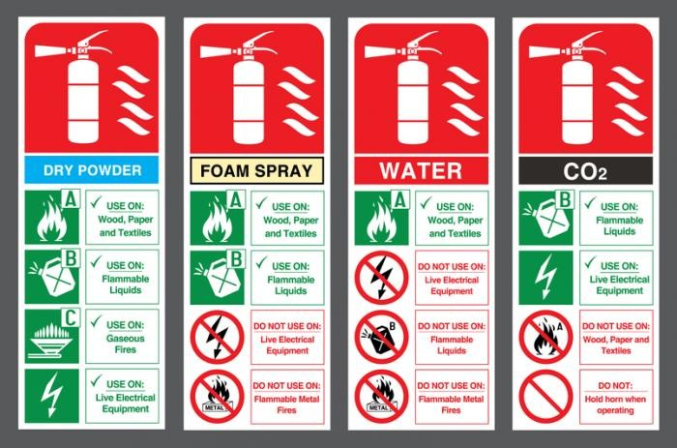
Fire extinguisher Types for the relevant class of Fire

Slide 8
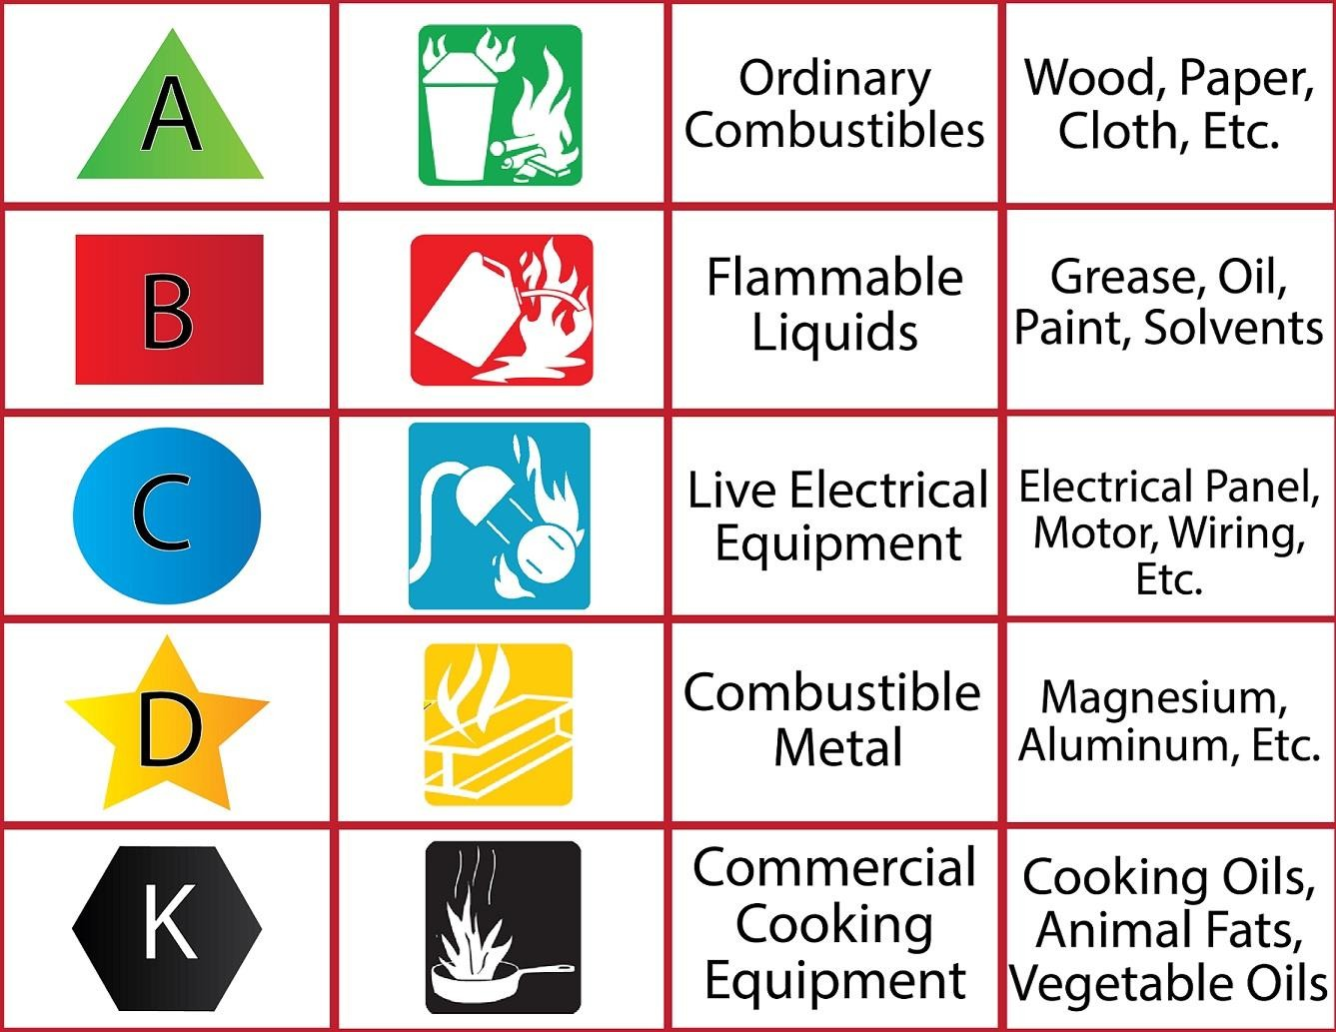
Cont….

Slide 9
4.1 Explain the purpose of safe working conditions and Procedures
4.1.2 Identify safety procedures to protect equipment from damage and data from loss.
What can damage a computer equipment?
Electrostatic discharge (ESD), harsh climates, and poor quality sources of electricity can cause damage to computer equipment.

Slide 10
4.1 Explain the purpose of safe working conditions and Procedures
Identify safety procedures to protect equipment from damage and data from loss
Electrostatic Discharge
When two electrically charged objects, such as the human body and an electronic device come into contact with each other, static electricity is discharged. This phenomenon is called ESD (Electrostatic Discharge).
Static electricity is the buildup of an electric charge resting on a surface.
This buildup may jump to a component and cause damage.
Only takes place when two objects that store different amounts of static electricity (different potentials) come in contact.

Slide 11
4.1 Explain the purpose of safe working conditions and Procedures
4.1.2 Identify safety procedures to protect equipment from damage and data from loss.
Electromagnetic Interference (EMI)
Is the intrusion of outside electromagnetic signals in a transmission media, such as copper cabling.
In a network environment, EMI distorts the signals so that the receiving devices have difficulty interpreting them.

Slide 12
4.1 Explain the purpose of safe working conditions and Procedures
4.1.2 Identify safety procedures to protect equipment from damage and data from loss.
Radio Frequency Interference (RFI)
RFI is the interference caused by radio transmitters and other devices transmitting in the same frequency.
Wireless networks are affected by Radio Frequency Interference (RFI).

Slide 13
4.1 Explain the purpose of safe working conditions and Procedures
4.1.2 Identify safety procedures to protect equipment from damage and data from loss.
Climate
If the environment temperature is too high, equipment can overheat.
If humidity is too low, chances of ESD increases, if too high, equipment
can suffer from moisture damage.

Slide 14
4.1 Explain the purpose of safe working conditions and Procedures
4.1.2 Identify safety procedures to protect equipment from damage and data from loss.
Power Fluctuation Types
The following types of AC power fluctuations can cause data loss or hardware failure:
Blackout - complete loss of AC power.
Brownout - reduced voltage level of AC (below 80%)
Spike - Sudden increase in voltage that lasts for a very short time period
Power surge - Dramatic increase in voltage above the normal flow of
electrical current.

Slide 15
4.1 Explain the purpose of safe working conditions and Procedures
4.1.2 Identify safety procedures to protect equipment from damage and data from loss.
Power Protection Devices
Surge suppressor - helps protect against damage from surges and spikes.
Uninterruptible Power Supply (UPS) - helps protect against brownouts and blackouts.
Standby Power Supply (SPS) - Helps protect against potential electrical
power problems by providing a backup battery to supply power.

Slide 16
4.1 Explain the purpose of safe working conditions and Procedures
4.1.3 Identify safety procedures to protect the environment from contamination
Computers and peripherals contain materials like heavy metals
such as cadmium, lead, or mercury that can be harmful to the environment.

Slide 17
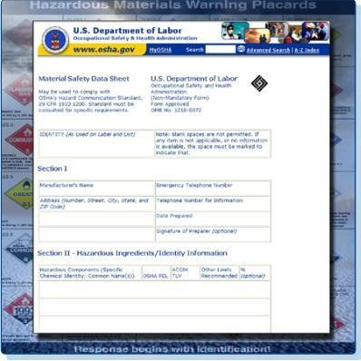
4.1 Explain the purpose of safe working conditions and Procedures
4.1.3 Identify safety procedures to protect the environment from contamination
Material Safety and Data Sheet
A Material Safety and Data Sheet (MSDS) is
a fact sheet that summarizes information about
material identification, including hazardous
ingredients that can affect personal health,
fire hazards, and first aid requirements.

Slide 18
4.1 Explain the purpose of safe working conditions and Procedures
3.1.3 Identify safety procedures to protect the environment from contamination
Proper Disposal of Batteries and CRTs
Batteries and CRTs often contain rare earth metals that are harmful to the environment like lead, mercury, lithium and others.
Mercury is commonly used in the manufacturing of batteries and is extremely toxic and harmful to humans.

Slide 19
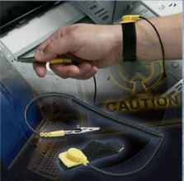
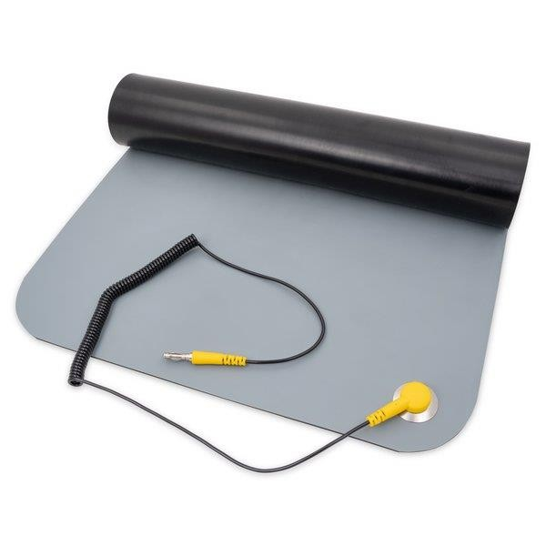
4.2 Hardware tools and their purpose
A toolkit should contain all of the tools necessary to complete
hardware repairs.
ESD Tools - Antistatic wrist strap and Antistatic mat
An antistatic wrist strap is used to prevent
ESD damage to computer equipment.
An antistatic mat is used to stand on or to
place hardware on to prevent static electricity
from building up.

Slide 20

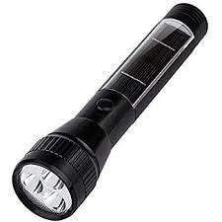

4.2 Hardware tools and their purpose
Hand Tools
Most tools used in the computer assembly process are small hand tools.

Slide 21

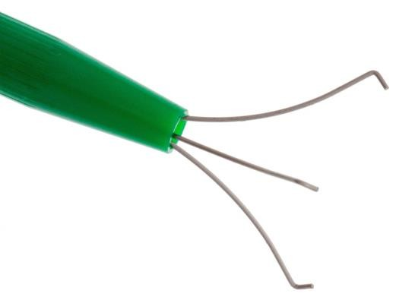
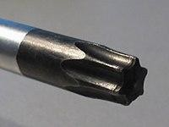


4.2 Hardware tools and their purpose
Hand Tools
Most tools used in the computer assembly process are small hand tools.

Slide 22
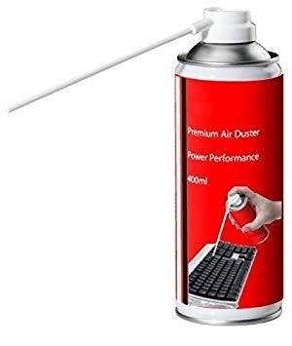


4.2 Hardware tools and their purpose
Cleaning Tools
Appropriate cleaning tools ensures that computer components are not damaged during cleaning.

Slide 23
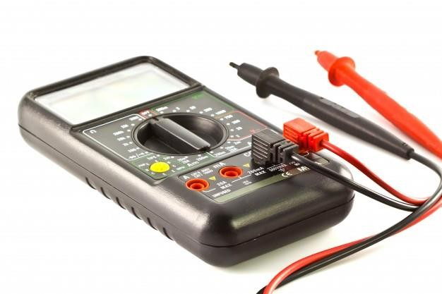
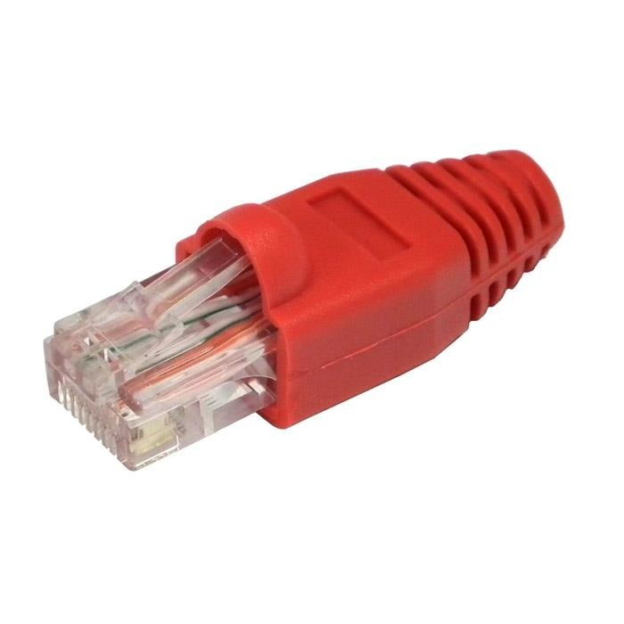
4.2 Hardware tools and their purpose
Diagnostic Tools
A digital Multimeter and a loopback adapter are used to test hardware.

Slide 24
4.3 Software tools and their purpose
Disk Management Tools
Fdisk or Disk Management - creates and deletes partitions on a hard drive.
Format - prepares a hard drive to store information.
Scandisk or chkdsk - Checks the integrity of files and folders on a hard
drive by scanning the file system. These tools may also check the disk surface for physical errors.
Defrag – Optimizes space on a hard drive to allow faster access to programs and data

Slide 25
4.3 Software tools and their purpose
Disk Management Tools
Disk Cleanup – Clears space on a hard drive by searching for files that can be safely deleted
Disk Management – Initialize disks, creates partitions, and formats partitions
System File Checker (SFC) – Scans the operating system critical files and replaces any files that are corrupted.
One can use Windows bootable disk for troubleshooting and repairing corrupted files.

Slide 26
4.3 Software tools and their purpose
Protection Software Tools
Viruses, Spyware, and other types of malicious attacks can damage an OS, application and data.
Windows Security Center - it ensure software firewall; antivirus programs are running.
Antivirus Program - protects against virus attacks.
Antispyware Program – Protects against software that sends information about web surfing habits to an attacker.
Firewall Program - Runs continuously to protect against unauthorized communications to and from your computer.

Slide 27
4.3 Software tools and their purpose
Organizational tools and their purpose
It is important that a technician document all services and repairs.
These documents need to be stored centrally and made available to all other technicians.
The documentation can then be used as reference material for similar
problems that are encountered in the future.

Slide 28
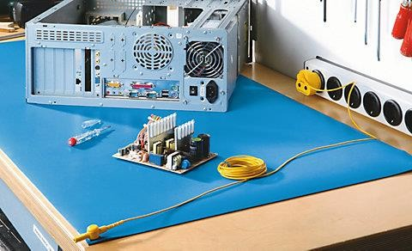
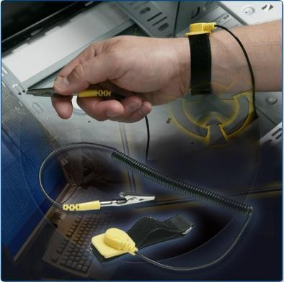
4.4 Implement the use of proper tool
Use of Antistatic mat Use of Antistatic wrist strap

Slide 29
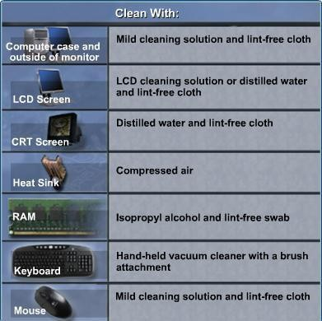
4.4 Implement the use of proper tool
Different tools and their
usefulness

Slide 30

End of Lecture for week 04
Any question ?

